Slide 1
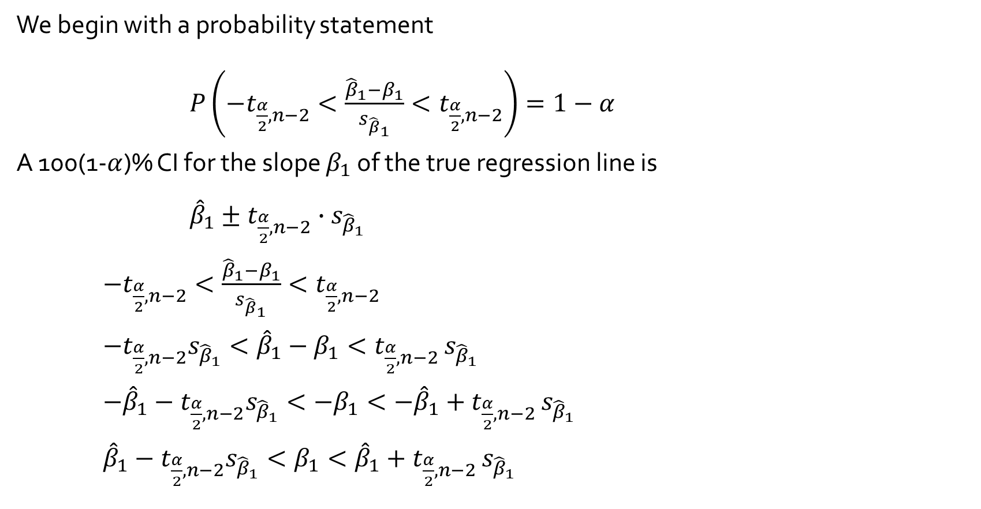
A Condifence Interval for $β_{1}$
We begin with a probability statement
$P\left(−t_{\frac{α}{2},n−2}<\frac{{\hat{β}}_{1}−β_{1}}{s_{{\hat{β}}_{1}}}<t_{\frac{α}{2},n−2}\right)=1−α$
A 100(1-$α$)% CI for the slope $β_{1}$ of the true regression line is
${\hat{β}}_{1}±t_{\frac{α}{2},n−2}∙s_{{\hat{β}}_{1}}$
$−t_{\frac{α}{2},n−2}<\frac{{\hat{β}}_{1}−β_{1}}{s_{{\hat{β}}_{1}}}<t_{\frac{α}{2},n−2}$
$−t_{\frac{α}{2},n−2}s_{{\hat{β}}_{1}}<{\hat{β}}_{1}−β_{1}<t_{\frac{α}{2},n−2}$ $s_{{\hat{β}}_{1}}$
$−{\hat{β}}_{1}−t_{\frac{α}{2},n−2}s_{{\hat{β}}_{1}}<−β_{1}<{−{\hat{β}}_{1}+t}_{\frac{α}{2},n−2}$ $s_{{\hat{β}}_{1}}$
${\hat{β}}_{1}−t_{\frac{α}{2},n−2}s_{{\hat{β}}_{1}}<β_{1}<{{\hat{β}}_{1}+t}_{\frac{α}{2},n−2}$ $s_{{\hat{β}}_{1}}$

Slide 2
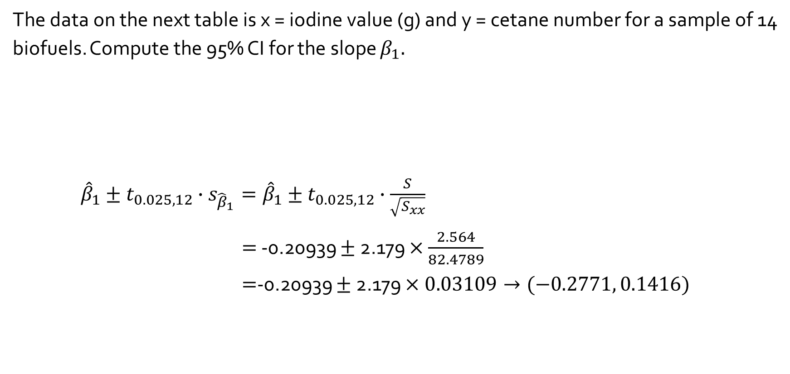
Example
The data on the next table is x = iodine value (g) and y = cetane number for a sample of 14 biofuels. Compute the 95% CI for the slope $β_{1}.$
${\hat{β}}_{1}±t_{0.025, 12}∙s_{{\hat{β}}_{1}}={\hat{β}}_{1}±t_{0.025, 12}∙\frac{S}{\sqrt{S_{xx}}}$
$=$ -0.20939 $±$2.179 $×$ $\frac{2.564}{82.4789}$
$=$-0.20939 $±$2.179 $×0.03109→(−0.2771, 0.1416)$
x | 132.0 129.0 120.0 113.2 105.0 92.0 84.0 83.2 88.4 59.0 80.0 81.5 71.0 69.2
y | 46.0 48.0 51.0 52.1 54.0 52.0 59.0 58.7 61.6 64.0 61.4 54.6 58.8 58.0

Slide 3
Steps in the analysis
> f <- lm(y ~ x)
> summary(f)
Call:
lm(formula = y ~ x)
Residuals:
Min 1Q Median 3Q Max
-3.9488 -1.5665 0.6817 1.0846 4.8974
Coefficients:
Estimate Std. Error t value Pr(>|t|)
(Intercept) 75.21243 2.98363 25.208 9.22e-12 ***
x -0.20939 0.03109 -6.734 2.09e-05 ***
---
Signif. codes: 0 ‘***’ 0.001 ‘**’ 0.01 ‘*’ 0.05 ‘.’ 0.1 ‘ ’ 1
Residual standard error: 2.564 on 12 degrees of freedom
Multiple R-squared: 0.7908, Adjusted R-squared: 0.7733
F-statistic: 45.35 on 1 and 12 DF, p-value: 2.091e-05

Slide 4
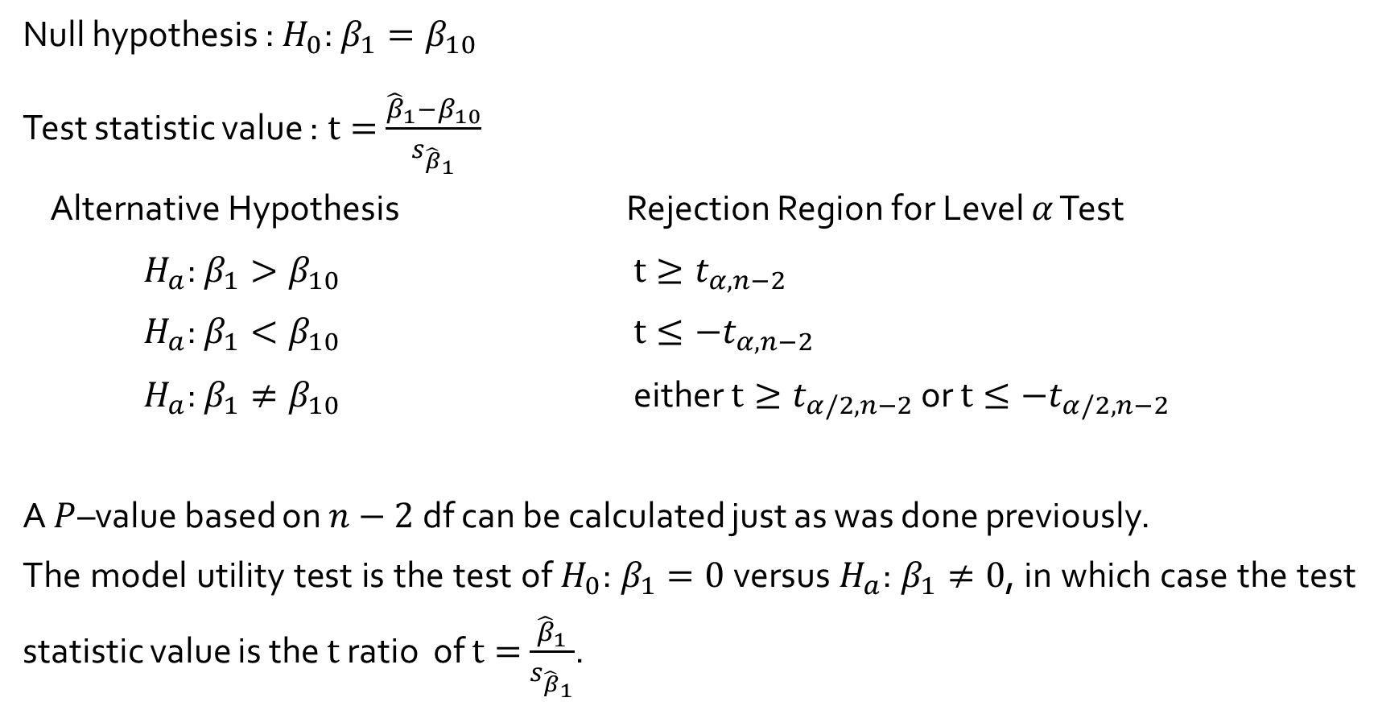
Hypothesis-Testing Procedures
Null hypothesis : $H_{0}$: $β_{1}=β_{10}$
Test statistic value :$t=$ $\frac{{\hat{β}}_{1}−β_{10}}{s_{{\hat{β}}_{1}}}$
Alternative Hypothesis Rejection Region for Level $α$ Test
$H_{a}$: $β_{1}>β_{10}$ $t≥t_{α,n−2}$
$H_{a}$: $β_{1}<β_{10}$ $t≤−t_{α,n−2}$
$H_{a}$: $β_{1}≠β_{10}$ either $t≥t_{α/2,n−2}$ or $t≤−t_{α/2,n−2}$
A $P$–value based on $n−2$df can be calculated just as was done previously.
The model utility test is the test of $H_{0}$: $β_{1}=0$versus $H_{a}$: $β_{1}≠0$, in which case the test statistic value is the $t$ ratio of $t=$ $\frac{{\hat{β}}_{1}}{s_{{\hat{β}}_{1}}}$.

Slide 5
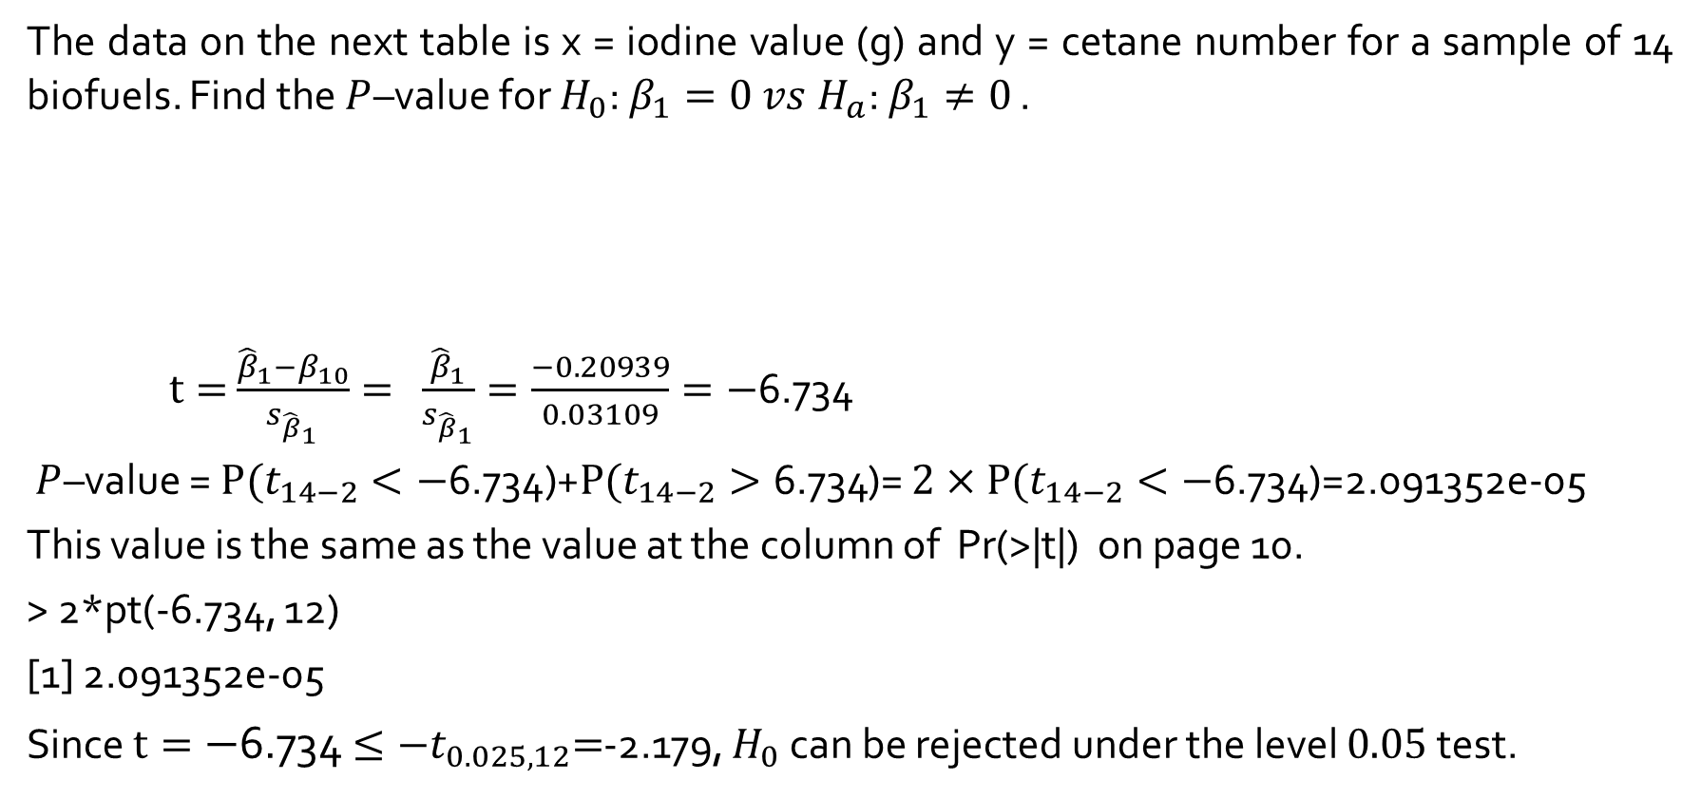
Example
The data on the next table is x = iodine value (g) and y = cetane number for a sample of 14 biofuels. Find the $P$–value for $H_{0}$: $β_{1}=0 vs H_{a}\text{: }β_{1}≠0$ .
$t=$ $\frac{{\hat{β}}_{1}−β_{10}}{s_{{\hat{β}}_{1}}}= \frac{{\hat{β}}_{1}}{s_{{\hat{β}}_{1}}}=\frac{−0.20939}{0.03109}=−$6.734
$P$–value = $P(t_{14−2}<−\text{6.734}\text{)+}P(t_{14−2}>\text{6.734}$)= $2×P(t_{14−2}<−\text{6.734}$)=2.091352e-05
This value is the same as the value at the column of Pr(>|t|) on page 10.
> 2*pt(-6.734, 12)
[1] 2.091352e-05
Since $t=−$6.734 $≤{−t}_{0.025, 12}=$-2.179, $H_{0}$ can be rejected under the level $0.05$test.
x | 132.0 129.0 120.0 113.2 105.0 92.0 84.0 83.2 88.4 59.0 80.0 81.5 71.0 69.2
y | 46.0 48.0 51.0 52.1 54.0 52.0 59.0 58.7 61.6 64.0 61.4 54.6 58.8 58.0

